Slide 1
Foras Promineo Software

Slide 2
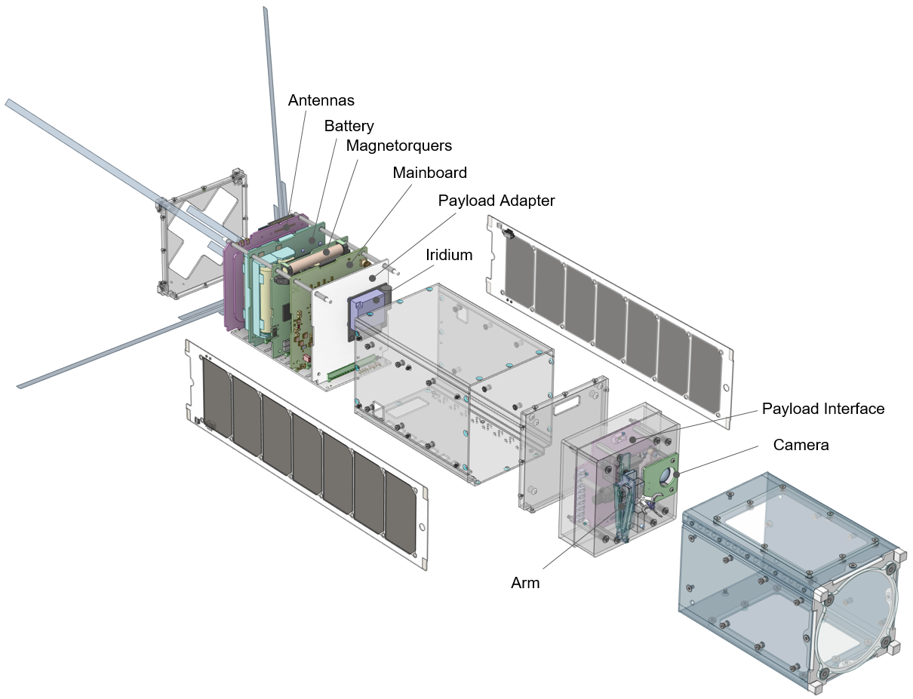
What is a cubesat / foras promineo ☺

Slide 3
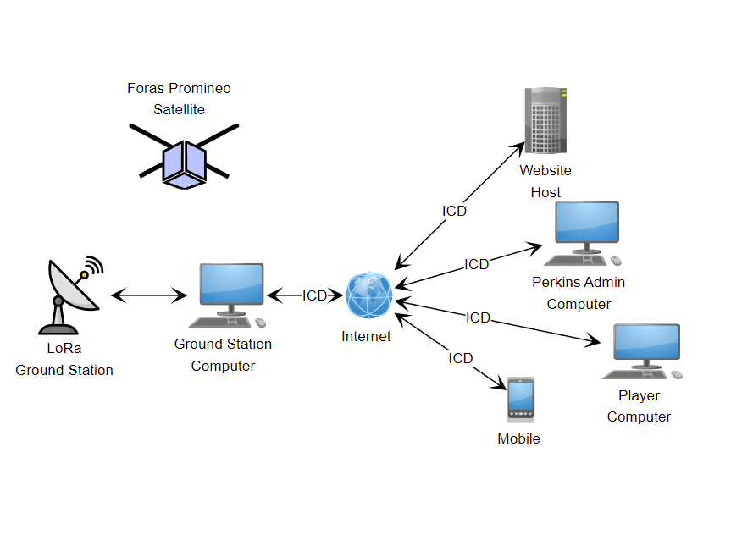
Block of how it operates in space

Slide 4
Conops
Host PC software
Ground Station PC Software
Satellite Software
Website

Slide 5
Satellite Software Preface
Satellite programming is mostly in circuitpython. Firmware is written in C, but Caden has taken care of that. (mostly just pin definitions anyways…)
Satellite programming is for a MICROCONTROLLER, so it is MUCH less powerful and fast than a PC!!
i.e. during normal execution there is <1MByte of RAM available for task execution.
Floating point is MUCH slower than integer operations
Data transactions over the radio are limited to 256 byte packets.
UART interface to payload is running at ~1MHz but is unverified.
Good practice is to just be mindful of what resources / typing your code is using.
Since python is dynamically typed, type casting in this application is quite important!
i.e. differences between a bool, int, float, and string object.
Also be aware of various decorations like the 0x (hex) or b’’ (binary) prefix, or @property.setters

Slide 6
Preface (cont.)
A lot of the backround lower-level libs have been written by Max Alvarez (guy who developed pycubed architecture) or wrote and modified by Caden (me)

Slide 7
Using Github for software slide

Slide 8
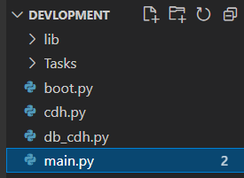
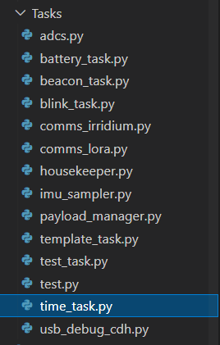
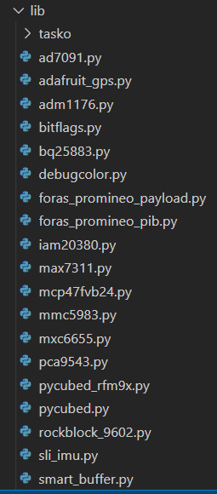
Project File Structure
Lib Directory:
All lib files for usage. Each lib follows a fairly similar format
Top Level:
cdh, boot, and main files
Task Directory:
Tasks

Slide 9

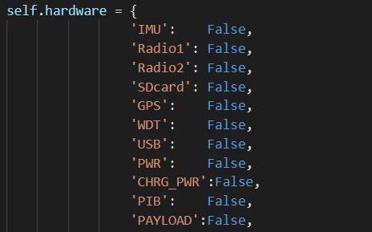
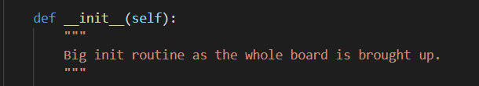
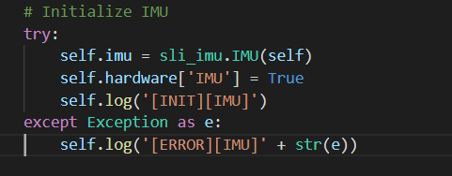
Master Library
Init routine initializes each device in self.hardware
Each initialization for the devices is within its own try – except clause.
Hardware dictionary for each device in this library
Example device init.

Slide 10
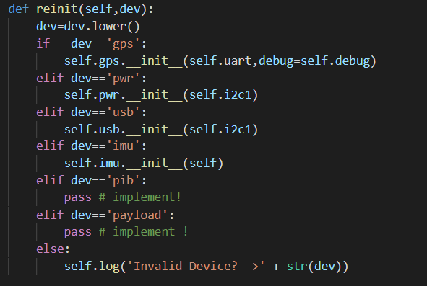
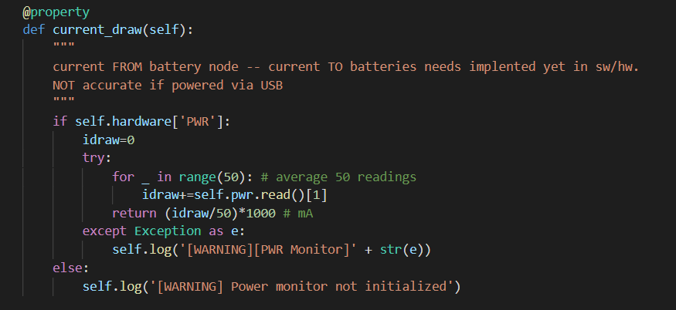
Master Library
Every board-level hardware lib has a reinit procedure !!!
Example of a property, i.e. class variable

Slide 11
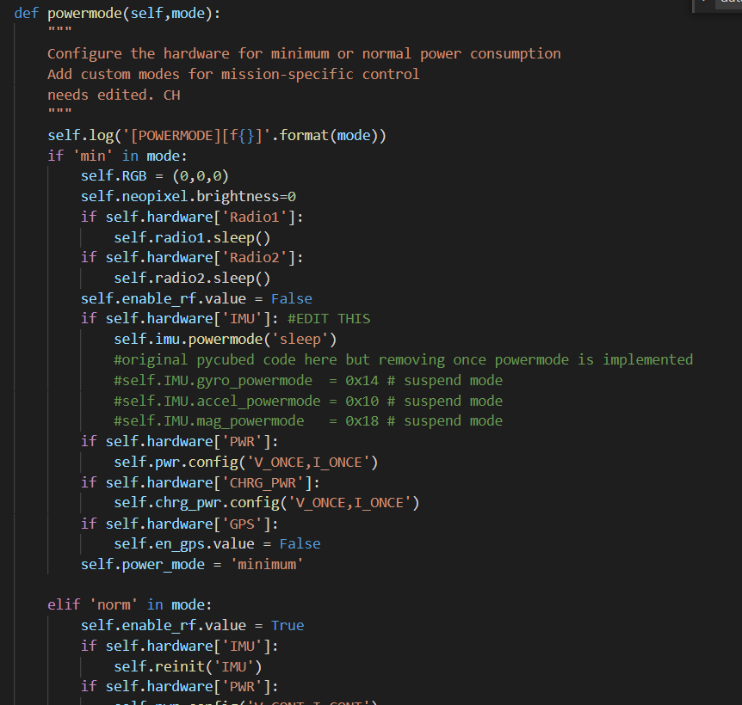
Master Library
Two power modes, min and norm.
*will probably change
Handling and initiating different power modes is to be implemented in housekeeper.py task*** verify

Slide 12

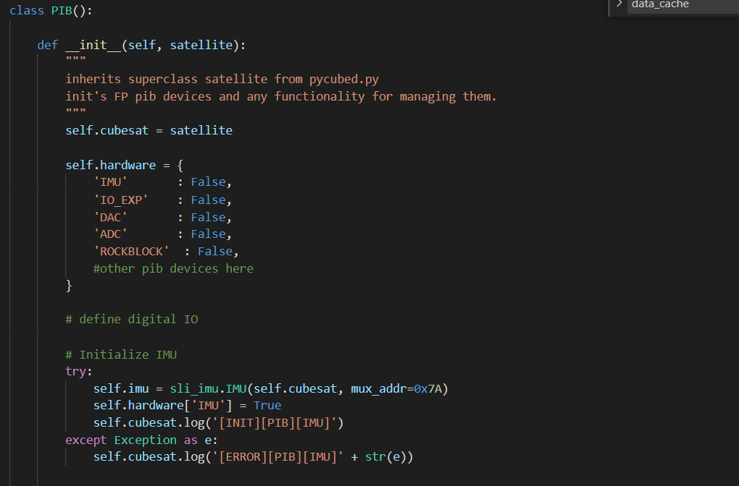
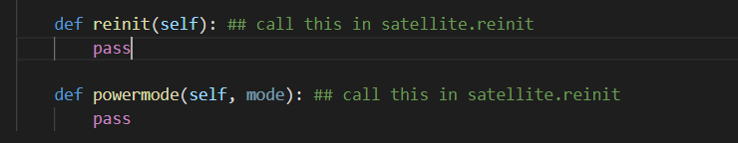
Sub library example

Slide 13
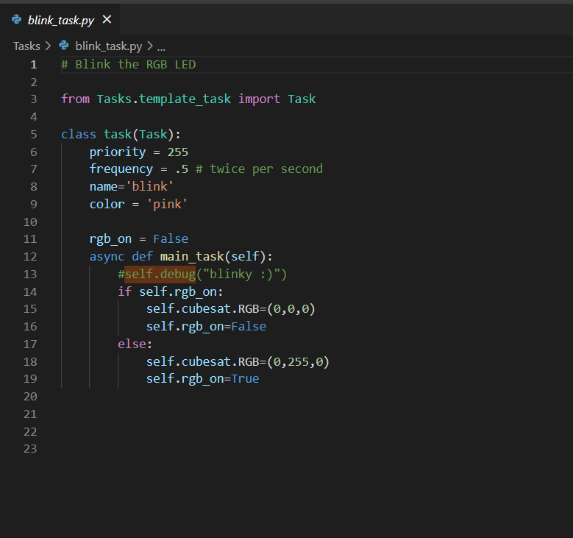
Anatomy of a Task
The mainboard executes tasks via a task scheduler
This is a task that blinks the led.
It is a subclass of task from template_task.py
When the task is executed, it runs the code within main_task.
Pycubed.py is self.cubesat
See priority and frequency for setting when a task will run

Slide 14
Current Progress (as of 6/1/21)
Mainboard is functional and all peripherals are coded in.
A new design revision will be made soon with some new features and some pinout changes.
Payload interface board libraries in progress
~90% complete, waiting on some parts and another design rev for the final design
Tasks have been started, but nothing of substance there just trying to get a good background set up
Some PC/website software has been written.

Slide 15
Things to Do:
Define operating states and what tasks should run at what times
Code high-level functionality
i.e. all the tasks, commands, data handling
Define radio>mainboard>payload data exchange for target bitrate
Test it for extended periods extensively
Make sure all code written is executed successfully on ground
Fault handling is EXTREMELY important in this application
Code pc host software to display live telemetry and simulate operations
Code PC ground station software

Slide 16
Phase 1 Plan
Pair 1 will define and code simulation and data interface to host PC (main priority #2)
We image a python program with a gui and real-time telemetry data updating, Marek started something like this but it really only uploaded new code to the device
Pair 2 will define and start to code the payload operation (main priority # 1)
Will be discussed in a moment
Once host software is in a good state, it can start to be tested by Pair 1 Implementing the ADCS (main priority #3)

Slide 17
USB Interface
Mainboard
Host PC
Circuitpython REPL terminal
Read debug data to display on GUI
Circuitpython REPL
All debug data is also printed here
USB
Usb_cdc.terminal
Usb_cdc.data
Db_cdh and simulation handling
Read/send cb_cdh and simulation commands

Slide 18
Top Level Simulation / Debug Interface Flowchart
Mainboard
Host PC
Usb connected?
Send db_cdh commands to device from user GUI
No
Yes
Set all simulation flags to 0
Look at usb_cdc.data port for new command
Execute command if detected
Value simulation flag True?
Query host for simulation data
Send queried simulation value over
Debug Data Stream Output
Gather data from Debug data stream and display on GUI nicely

Slide 19
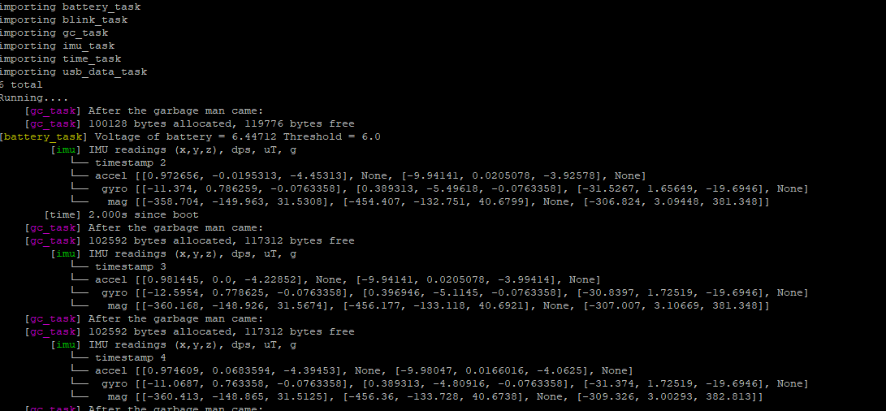
REPL terminal and data stream
Regular circuitpython terminal.
Cubesat.debug prints data here
Print() command also prints here
Ctrl-C to end and ctrl-D to reload

Slide 20
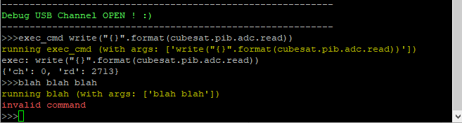
Debug command terminal
First asci encoded word “exec_cmd” is the keyphrase for the command to run
Then “ “ space for arguments passed
All arguments are separated by “arg0,arg1” comma right now, not “arg0, arg1“ comma space
Not implemented yet, but this is where the device will also ask for simulation data

Slide 21
Main Operation Modes of Satellite
Each mode will have several substates.
Each mode/state will probably have specific tasks/ change task settings on the fly.
STARTUP MODE
SAFE MODE
IDLE MODE
PAYLOAD MODE
Runs once, x amount of time after initial deployment
Deploys deployables
Initial system checkout and startup
i.e. ADCS detumble,
ADCS calibrate,
ETC.
Turns everything off, sleeps for x amount of time when it will re-check everything and try to re-enter idle mode.
Probably will beacon once for help during this. An override function may be implemented
Device in this mode most of time.
Will beacon over LoRa looking for commands from ground.
Payload will be powered off.
ADCS in point mode
Initiated from idle mode to start payload experiment.
Recieves data stream over LoRa for next arm/exec command
Sends data stream down of payload camera, arm, and important telemetry.
ADCS in payload_comp() mode, where it will hold and try to ignore arm torque exerted.
If time, implement where cubesat will point at ground for better data transmission and reception.
A “frame”-like interface will probably have to be defined with a strict state machine, error handling, and no getting held up on lost data.

Slide 22
STARTUP Mode
Wait x amount of time
Deploy

Slide 23
Safe Mode

Slide 24
Idle Mode

Slide 25
Basic Radio Packet Structure
Sender Transmit
Header
1-4 bytes
CMD
1 byte
ARGs
1-x bytes
CRC
(ideally CRC-32)
4 bytes
Termination
1 byte
Receiver ACK (sent after header last packet)
1-4 bytes

Slide 26
Header Structure
Byte 1= packet no.
Byte 2 = number of packets in Tx
Byte 3 = number of bytes in Tx
Byte 4 = crc flag (can add more flags)

Slide 27
Over the Air (OTA)(Radio) Commands
2 byte command code
Binary encoded, along with args passed.
Codes on github are not the ones we should use for flight

Slide 28
Minimum Functional Payload
Send Payload Init command w/ payload op settings
Send ACK
Send control data at x freq
Send ACK response
ACK
add a flag to request to send a photo down after X rx’s
Receive photo every after x transmissions
Send photo

Slide 29
Payload Mode

Slide 30
adcs_task.py

Slide 31
payload_task.py

Slide 32
db_cdh.py / usb_data_task.py
Debug commands sent via host PC
Also implement ability to run regular flight cdh.py commands with normal output over radio and debug info via USB.

Slide 33
cdh.py
All of the “in flight” commands will go here.
i.e. setting persistent settings, imitating payload, printing log, printing telemetry, etc.
Some commands like exec, query, and hreset will probably have to be password-protected in addition?

Slide 34
Beacon tasks
Idle mode beacon tasks for LoRa and Irridium.
Lora beacons at X frequency and Irridium beacons at X frequency. Both do CDH handling and can initiate a payload operation. TBR if iridium can handle a payload operation.

Slide 35
Telemetry gathering tasks
Imu_task.py
Reads IMU data and overwrites data in cubesat.data_buffer{“imu”}.
GPS_task.py
Reads GPS data and overwrites data in cubesat.data_buffer{“gps"}
Temperature_task.py
Reads various temperatures and overwrites data in cubesat.data_buffer{“temp”}
Turns overheating devices off.
Time_task.py
Prints time data.
Battery_task.py
Gathers battery information and power readings. Initates safe mode if low battery is detected.

Slide 36
Housekeeper task
Maybe break into a bunch of smaller tasks?
If a device has faulted out (happens more than you think!) it will attempt to reset the device(s) ~1x per hour?
Preforms a daily hard reset to the satellite
Other housekeeping tasks?
gc_collect is already it’s own thing running at 2Hz

